Slide 1
Government Polytechinc,Yavatmal Android Application For Potholes Detection System Course- Capstone Project Planning
Submitted by
Name of group members: Guided by:
Ayush Chiddarwar (1970) Prof.G.K.Yadav Sir
Pranjal Sharma (1854)
Diksha Mohod (1839)
Prajwal Chaudhri (1965)
Manthan Watile (1969)

Slide 2
Content
Acknowledgement
Introduction
Objectives
Development Requirements
Requirements Analysis
Diagram
Scope For Future Work

Slide 3
Acknowledgement
We wish to thank our project guide Prof. G. K. Yadav Sir for their help and guidance. The work was also supported by the computer department, Government Polytechnic,Yavatmal.

Slide 4
Introduction
Project Background:
Due to heat, cold and rain the roads forms crakes and gaps over it. Due to such gaps and creaks people face many issues and difficulties while driving their vehicle.
To reduce the difficulties and efforts of users and Government we created a pothole detection system, from which we will collect the data related to the depth, location and the intensity of the holes on the roads by which government can design their model and budgets to make the road repair sustainable, fast as well as the user can know the road conditions before he travels.

Slide 5
Objectives
The objectives of this project were to create an application
That can identify a change in acceleration unique to potholes(excludes speed bumps)
That can obtain the most accurate location data possible
That is able to transmit data to an external destination
That has a good user interface –easy to use, clear instructions

Slide 6
Development Requirements
This project was developed using the android framework and android studio toolkit. For the better convenience and wide user network.
We decided to use accelerometer sensor for measuring the acceleration of a moving body and we use longitude and latitude for pointing the location of moving body also we used graph to show intensity of potholes.

Slide 7
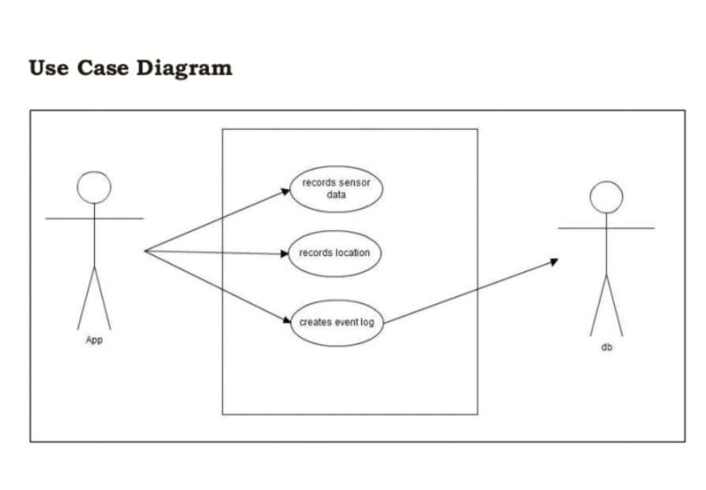
Requirement Analysis
The system should be able to detect events in real time.
The system should use a generic android os based smart phone that has built in accelerometer sensor as the hardware/software platform.
The system should be able to run on different smart phone models with different parameters.
Systems should be able to detect events during driving in different vehicle types such as passenger cars, minivans, buses, bike, etc.

Slide 8
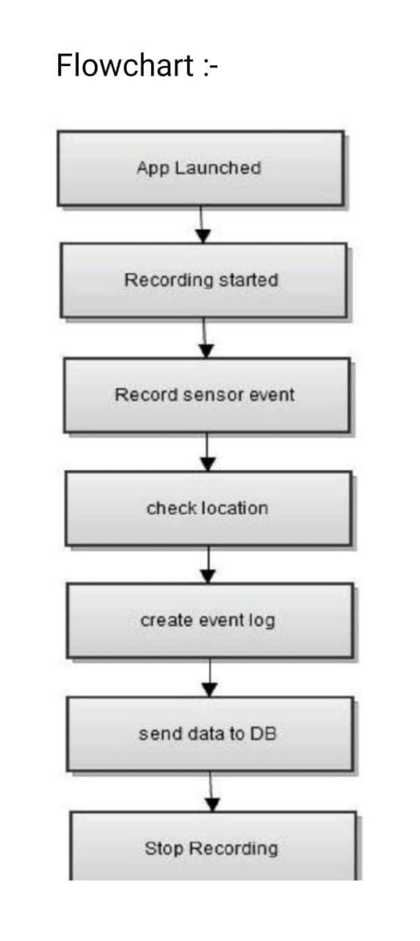
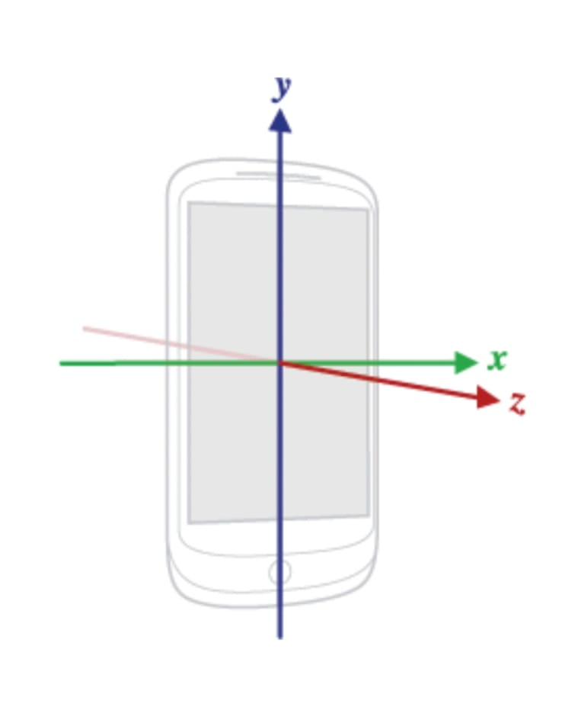
Diagram

Slide 9
Scope For Future Works
In future we can use this system for safety and maintenance of roads. Potholes can be auto detected using acceleration data collected using sensors mounted on the vehicle.
We can use sensor network deployed over a public transport system to monitor road surface condition.
The proposed system can be further improved to display alerts such as Bad road ahead in order to help the driver be more alert while driving/riding on such roads.

Slide 10
Thank You..

